Slide 1
A knowledge graph completion model integrating entity description and network structure
Chuanming Yu¹, Zhengang Zhang¹, Lu An²
1 Zhongnan University of Economics and Law , Wuhan
2 Wuhan University, Wuhan
Presenter：Chuanming Yu

Slide 2
Introduction
Related work
Research questions and the proposed method
Experiments and discussions
Conclusion
CONTENTS

Slide 3
PART 01 Introduction

Slide 4
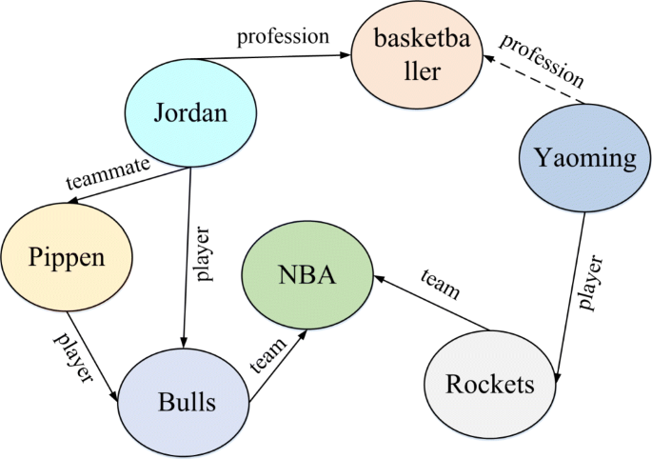
1. Introduction
Knowledge graph completion
knowledge graph completion (KGC) aims to predict the missing information in the knowledge graph, that is, the prediction of tail entities under the premise of given head entity and relationships, or the prediction of head entity under the premise of given tail entity and relationships.

Slide 5
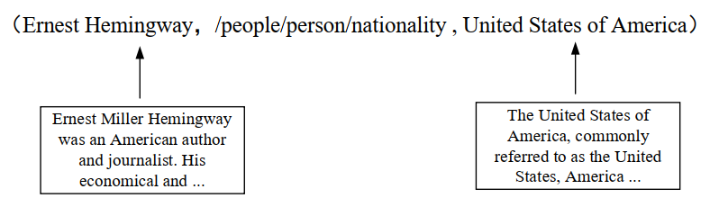
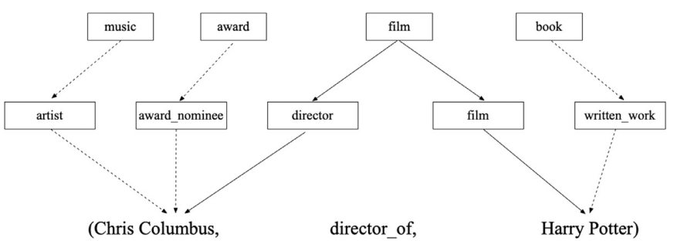
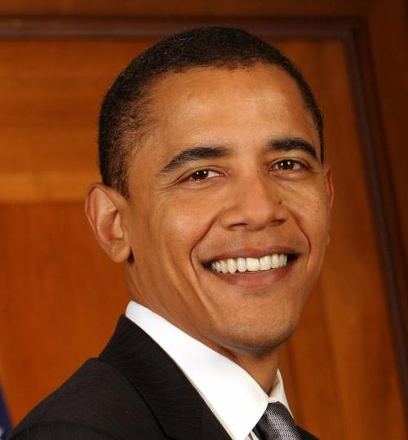
1. Introduction
It is worth noting that most KGC models only use the triple structure in the knowledge graph when training entity and relationship representation, while many rich information from other sources such as entity description, attributes, etc., has been ignored.
Notes:
这儿可以讲一下实体的丰富外部信息

Slide 6
PART 02 Related Work

Slide 7
2. Related Work
According to the information used in the KGC models, we divide KGC into two categories:
The structure-based model
TransE(Bordes, Usunier, Garcia-Duran, Weston, and Yakhnenko, 2013)
TransH（Wang, Zhang, Feng, and Chen ,2014 )
TransR (Lin, Liu, Sun, Liu, and Zhu,2015)
ComplEx (Trouillon, Welbl, Riedel, Gaussier, and Bouchard, 2016)
TuckER (Balažević, Allen, and Hospedales, 2019)
ConvE (Dettmers, Minervini, Stenetorp, and Riedel, 2018)
ConvR (Jiang, Wang, and Wang, 2019)
HypER (Balažević, Allen, and Hospedales, 2019)

Slide 8
2. Related Work
The KGC model integrating external information
DKRL (Xie, Liu, Jia, Luan, and Sun, 2016)
EDGE (Zhou, Wang, and Jiang, 2019)
KG-BERT (Yao, Mao, and Luo, 2019)

Slide 9
PART 03 Research questions and the proposed method

Slide 10
3. Research questions and the proposed method
In this study, we propose a novel Entity Description Augmented Knowledge Graph Completion (EDA-KGC) model, and investigate the following research questions on this basis.
（1） Compared with the traditional KGC models and the ones that incorporate external information, does the proposed model have better effect in the KGC task?
（2） For the KGC model integrating entity description and network structure, what are the key influencing factors?

Slide 11
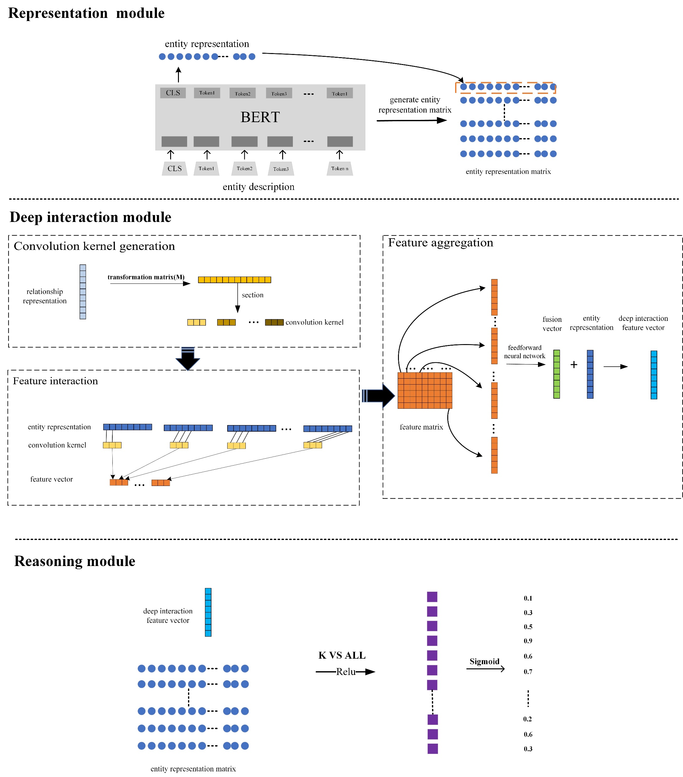
3. Research questions and the proposed method
The proposed framework (EDA-KGC):
Representation module
Deep interaction module
Reasoning module

Slide 12
PART 04 Experiments and Discussions

Slide 13
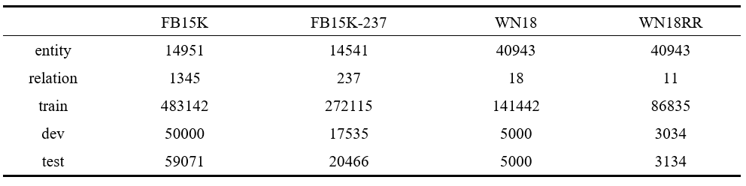
4. Experiments and Results
Dataset
To inverstigate the research questions proposed in this paper, four datasets are selected i.e., FB15K, FB15K-237, WN18 and WN18RR.

Slide 14
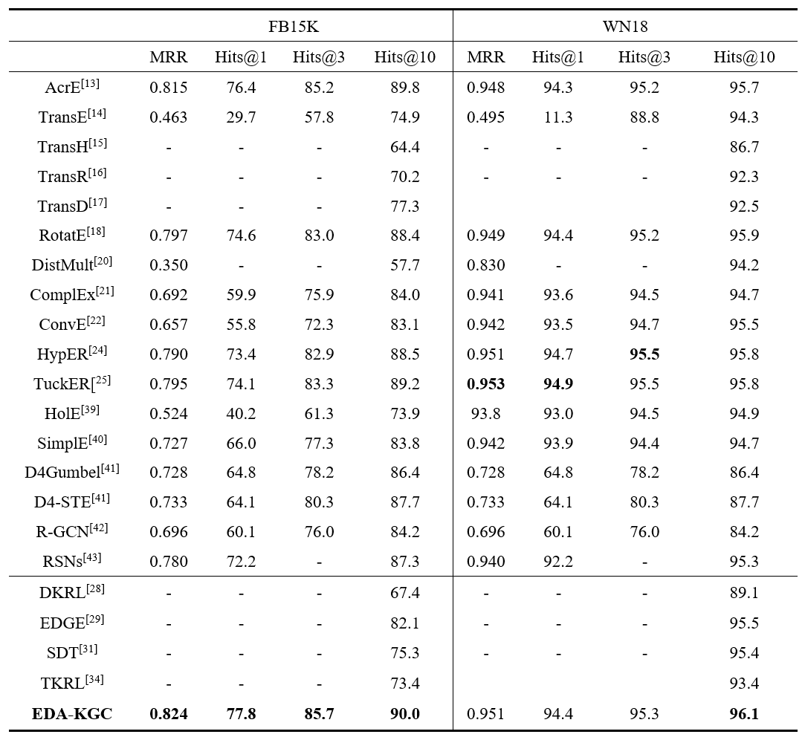
4. Experiments and Results
The experimental results of the comparative study

Slide 15
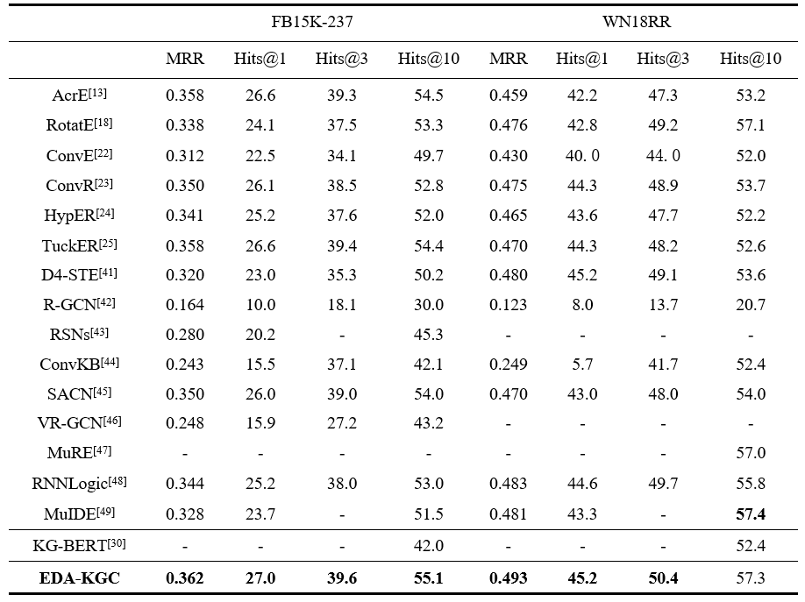
4. Experiments and Results
The experimental results of the comparative study

Slide 16
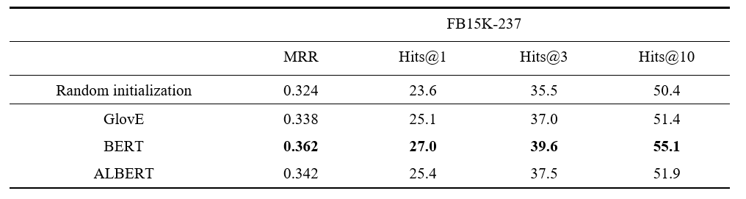
4. Experiments and Results
The influence of different embeddings on the performance

Slide 17
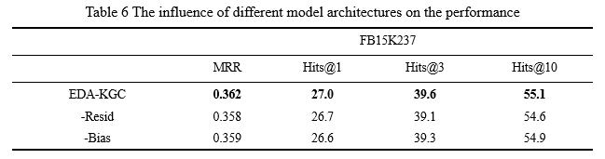
4. Experiments and Results
The influence of different model architectures on the performance

Slide 18
4. Experiments and Results
The influence of different model architectures on the performance

Slide 19
PART 06 Conclusion

Slide 20
6. Conclusion
Conclusion
We propose a novel model, namely Entity Description Augmented Knowledge Graph Completion (EDA-KGC), which fully leverages both the entity description and the network structure, and solve the problem of knowledge graph completion with a high generalization ability among different datasets.
We conduct intensive experiments to evaluate the performance of the proposed EAD-KGC model on four datasets, namely FB15K, WN18, FB15K237, and WN18RR. The experimental results demonstrate that our approach outperforms most of the state-of-the-art methods.

Slide 21
6. Conclusion
Future work
We will further explore how to enhance knowledge graph representation through multimodal information such as images, so as to further improve the effect of knowledge graph completion task.

Slide 22


THANKS
yucm@zuel.edu.cn
yuchuanming2003@126.com

